Slide 1

Calculator App: HTML, CSS, and JavaScript
This project guides you through building a calculator app using HTML, CSS, and JavaScript. It provides a foundation for understanding web development concepts, including user interface design and dynamic functionality.
AS
by Akshita Singh

Slide 2

Importance of a Calculator App
Accessibility
Education
Calculators are essential tools for everyday tasks, from simple arithmetic to complex calculations. They provide accessibility to calculations for anyone, regardless of their mathematical expertise.
Calculator apps are valuable learning tools for students of all ages. They can help visualize concepts, practice problems, and reinforce mathematical skills.
Productivity
In professional and personal settings, calculators streamline calculations and enhance productivity by reducing errors and saving time.

Slide 3
HTML Structure: Building the Calculator Interface
Basic Structure
Display Area
Button Grid
The HTML structure defines the layout and elements of the calculator. It includes containers for the display, buttons, and other components.
This section displays the input and results of calculations, typically using an input field with appropriate styling.
The button grid contains buttons for numbers, operators, and special functions, organized in a logical layout for ease of use.

Slide 4

CSS Styling: Enhancing the Visual Appeal
1
Layout and Dimensions
2
Typography and Colors
CSS controls the size, position, and alignment of elements within the calculator interface.
Choose fonts, colors, and spacing to create a visually appealing and user-friendly design that aligns with the app's purpose.
3
Button Styling
4
Responsiveness
Button styles, including background colors, border radii, hover effects, and transitions, provide visual feedback and enhance the user experience.
Ensure the calculator app adapts well to different screen sizes and devices by using media queries and flexible layout techniques.

Slide 5
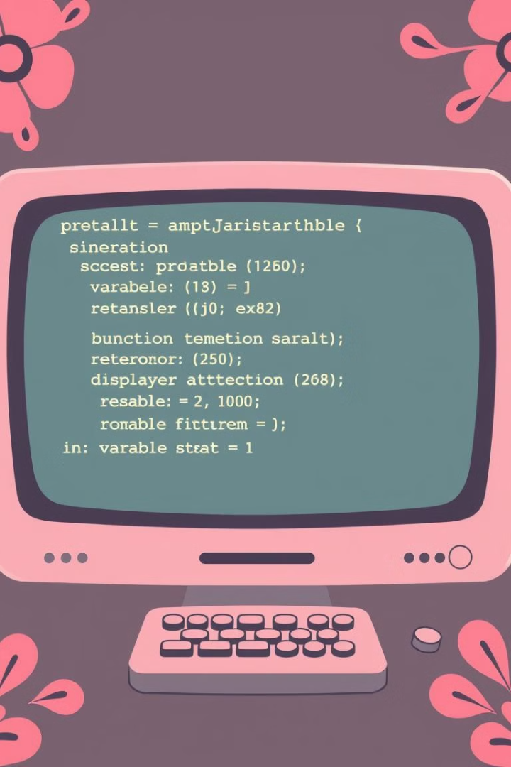
JavaScript Logic: Implementing Calculator Functions
1
Input Handling
Capture user input from button clicks and display it in the calculator's display area.
2
Operator Logic
Implement logic for handling arithmetic operators (+, -, *, /) and their respective calculations.
3
Result Display
Display the calculated result in the display area, ensuring clear and accurate presentation.

Slide 6




Adding User Interactivity: Event Handling
Event Listeners
Attach event listeners to buttons to capture user interactions, such as clicks or touches.
Callback Functions
Define functions that are triggered when specific events occur, such as button clicks or key presses.
Dynamic Updates
Update the calculator display and internal state based on user interactions, ensuring real-time feedback.

Slide 7
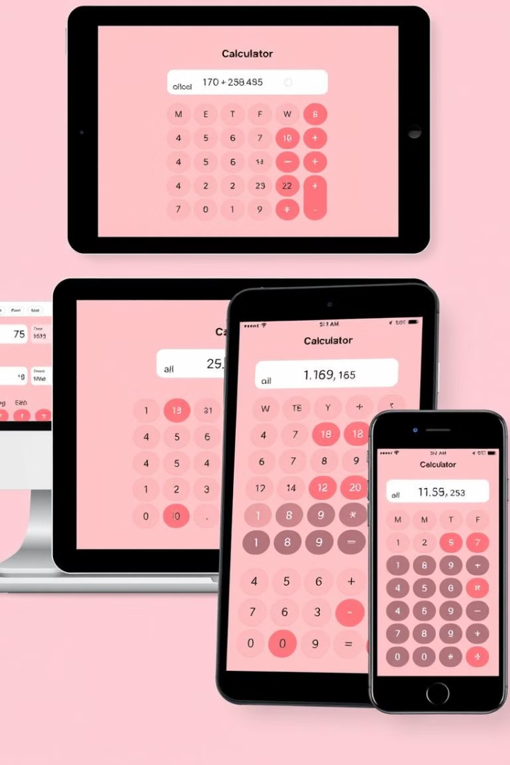
Responsive Design: Adapting to Different Devices
Desktop
Large screen with a more spacious layout for the calculator interface.
Tablet
Medium screen with a layout that adapts to the smaller display while maintaining essential functionality.
Mobile
Small screen with a simplified layout and touch-optimized controls for optimal usability.

Slide 8




Conclusion: Recap and Next Steps
Code Review
Review your code for accuracy, efficiency, and potential improvements.
Enhancements
Explore adding new features, such as advanced functions, themes, or user customization options.
Deployment
Deploy your calculator app to a web server so it can be accessed by users.

